Slide 1
Enhanced ER Schema Diagram
Dr. Anand Bihari
SJT Annex- 203N
anand.bihari@vit.ac.in

Slide 2
The Entity (Review)
Entity Relationship (ER) Model – represents an object
Physical – person, car
Conceptual – school, company
ER model is based on the perception of the real world as a collection of objects with attributes
Attributes – describe the entity
Single, Multi-value
Composite, Simple
Derived, Stored

Slide 3
EER Model
Enhanced Entity Relationship (EER) – Data Modeling
EER shows complex relationships between objects in a database (multimedia, geographical).
Concepts of subclasses, superclass, specializations and generalizations.
Put concepts in diagram to form EER model.
EER diagrams allow refinements within the structures of entity types

Slide 4
Specialization
Specialization is the process of defining a set of subclasses of an entity type .
This entity type is called the superclass of the specialization.
Subclasses and Inheritance
An entities B is said to be a subclass of another entity A. If and only if it shares an “is-a” relationship with A.
Example: Car “is-a” vehicle.
Manager “is-a” Employee.
An entity of class B is said to be a specialization of entities of class A.
Conversely, entities of class A are generalization of the class B entities.

Slide 5
Model Shapes
When you have more than one subclass based on the same defining attribute (JobType), use
To show class/subclass relationships, use
Used for relationships between entity types
To show relationship between two different entity types, use
U

Slide 6
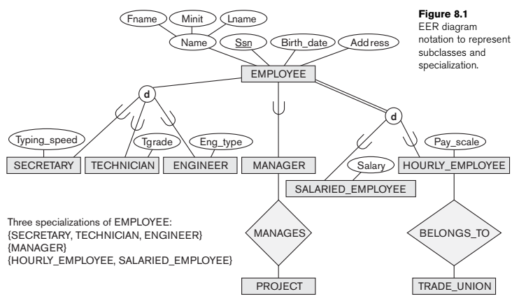

Slide 7
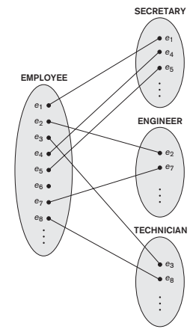

Slide 8
Specialization
The specialization process allows us to do the following:
Define a set of subclasses of an entity type
Establish additional specific attributes with each subclass
Establish additional specific relationship types between each subclass and other entity types or other subclasses

Slide 9
Generalization
Reverse processes of defining subclasses (bottom-up approach)
Bring together common attributes in entities
Example: CAR (with attributes color, price, max speed) and TRUCK (with attributes color, price) can be generalized into VEHICLE (with attributes color and price).

Slide 10
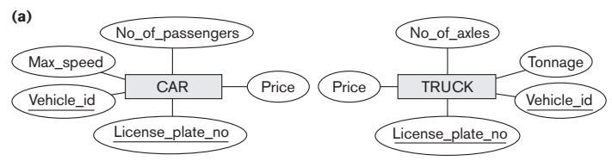

Slide 11
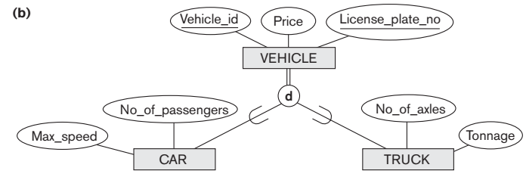

Slide 12
Constraints on Specialization and Generalization
There are two type of constraints in specializations.
Disjointness specifies that the subclasses of the specialization must be disjoint. The notation of disjoint constraint is
There are four possible constraints on specialization
Disjoint total
Disjoint partial
Overlapping total
Overlapping partial
Completeness
D

Slide 13
Union Types of Categories
In categories, different entries of the subclass may inherit attributes from different superclsses.
An entity in Category is a member of only one of its superclass
In specializations, all the subclasses inherit all the attributes of the superclass
Category types: Total or Partial
Ex: An account holder can be either an individual, a family and an institutions each of whom have its own attribute and keys.

Slide 14
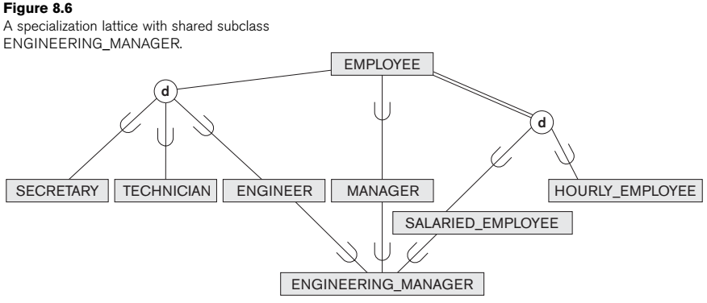
A specialization lattice (with multiple inheritance)

Slide 15
